Slide 1
FY15 Probation Automation Coordinating Committee Update
June 3, 2016
Commission on Technology

Slide 2
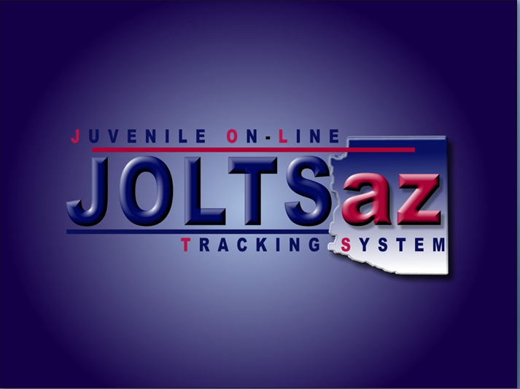

Slide 3
Juvenile Probation
Major Accomplishments in FY16
Rolled out JOLTSaz in Yuma, La Paz, Santa Cruz and Cochise counties (JOLTSaz now covers 60% of juveniles, 62% of complaints and 59% of petitions)
Implemented the JOLTSaz Spring Build, delivering 21 new features to the users
Rolled out CASAaz in Pinal, Pima, Yuma, La Paz, Gila, Yavapai and Santa Cruz
Obtained federal funding and started CASAaz Phase II
Built JTX functionality in JOLTSaz and successfully converted JTX data from the legacy system
Rolled out JusticeTools in Pima County including Case Plans for PO’s replacing AZYAS

Slide 4
Juvenile Probation
Plans for FY17
JOLTSaz scheduled rollout in remainder of calendar year 2016 - Yavapai, Mohave, Coconino
JOLTSaz scheduled rollout in calendar year 2017 - Pinal, Navajo, Apache, Gila, Graham, Greenlee
Continue to modify the feed to AOC’s Data Warehouse for each county at time of roll out
Continue CASAaz rollout and implement CASAaz Phase II
Construct CASA and FCRB functionality in JOLTSaz and CASAaz, enabling legacy DCATS system to be shut down
Implement AZYAS upgrade in Maricopa and the rural counties

Slide 5


Slide 6
Adult Probation
Major Accomplishments in FY16
Implemented the Bonsai Build, delivering enhancements that benefit APETS users
Built new UA/BA vendor interface to APETS that receives results from vendors and sends demographic data to vendors
Upgraded APETS Services to include UA and e-mail
Completed business requirements for Probation Tails
Completed business requirements for JWI CPSR Phase II

Slide 7
Adult Probation
Plans for FY17
Complete Probation Tails project
Complete JWI CPSR Phase II project
Start project to upgrade APETS code to C#

Slide 8


Slide 9
Maricopa County
Major Accomplishments in FY16
Continued development of iCISng criminal bench module which includes e-sentencing (enabled APD electronic filing of PSI reports)
Rolled out ICE notifications statewide
Deployed PSA risk instrument in pretrial services
Hired APD contract programmers to begin work on creation of web-based forms and court reports

Slide 10
Maricopa County
Plans for FY17
The biggest goal for next year is transitioning off of macros to web-based forms for all court paperwork and court reports
Also would like to explore a mobile application for probation officers in the field to access essential client information

